Slide 1
Eclipse Plug-in Development
Eclipse RCP Development Part 2
Advanced Topics

Slide 2
Contents
Product Configuration
Dependencies
Configuration
Launching
Splash
Branding
License
Update
Publish
Resources Hierarchy
Workspace
Resources

Slide 3
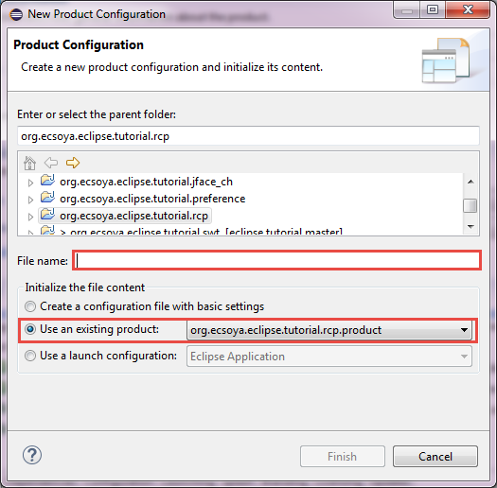
Product Configuration

Slide 4
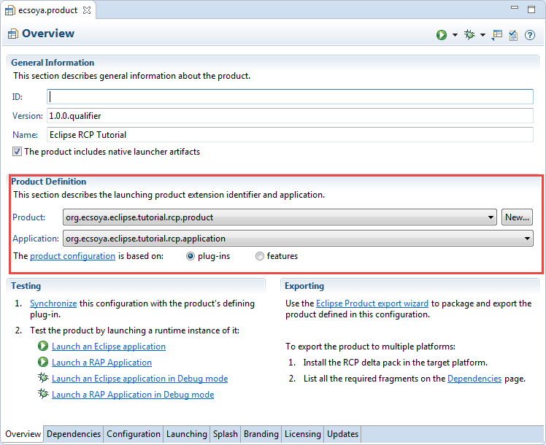
Product Configuration

Slide 5
Product Configuration
org.eclipse.core.runtime.products
<extension
id="product"
point="org.eclipse.core.runtime.products">
<product
application="org.ecsoya.eclipse.tutorial.rcp.application"
name="Eclipse RCP Tutorial">
</product>
</extension>

Slide 6
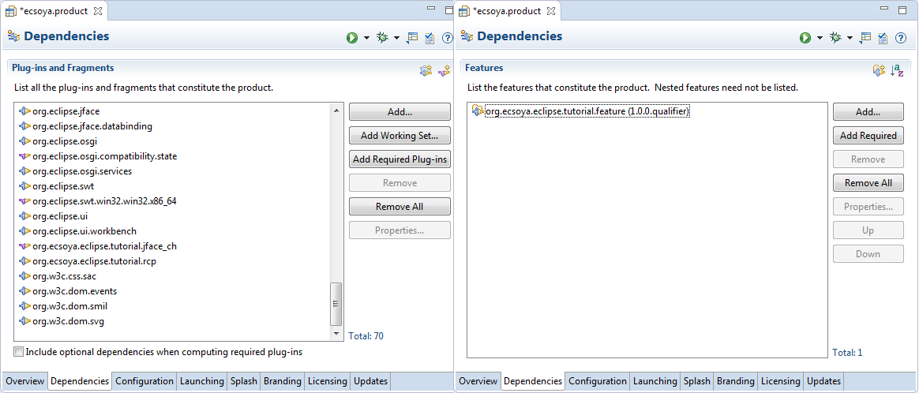
Product Configuration
Dependencies
plugins
features

Slide 7
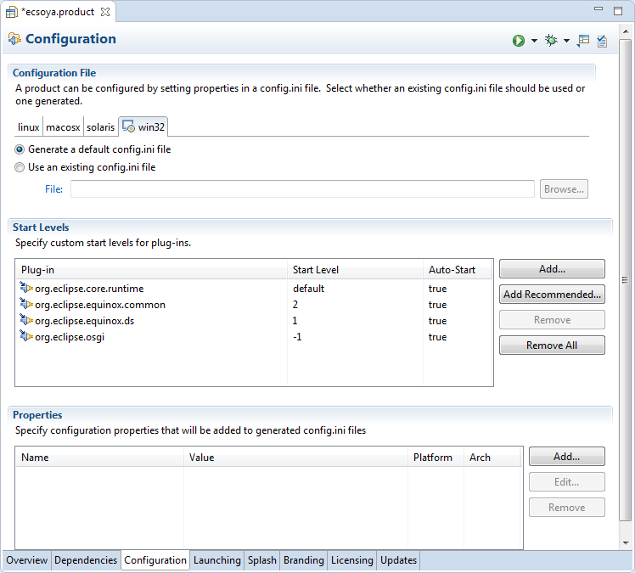
Product Configuration
Configuration
config.ini

Slide 8
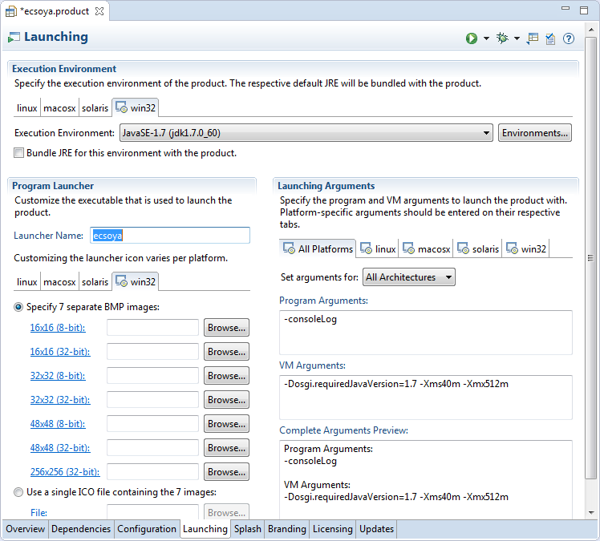
Product Configuration
Launch
Name
Icon
JRE
Arguments

Slide 9
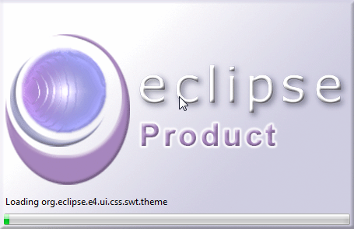
Product Configuration
Splash

Slide 10
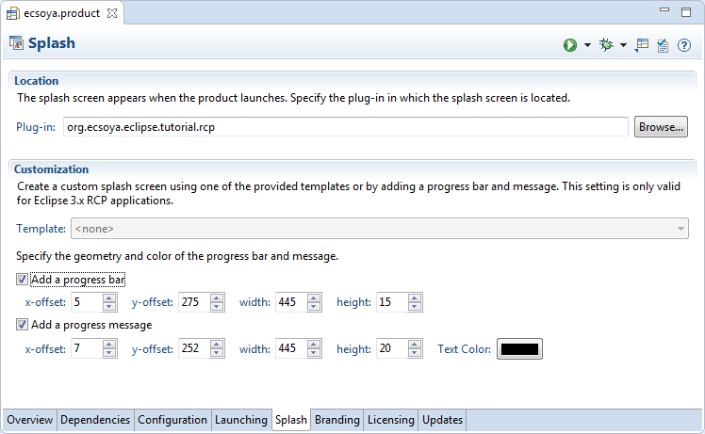
Product Configuration
Splash

Slide 11
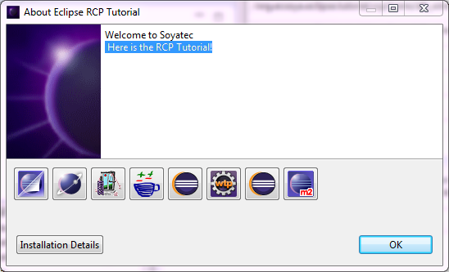
Product Configuration
Branding
Window Images
About Dialog
Welcome Intro

Slide 12
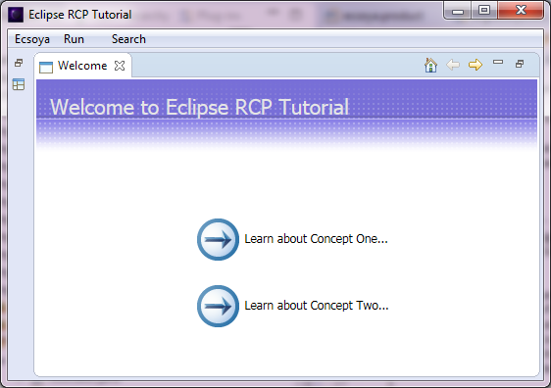
Product Configuration
Branding
Window Images
About Dialog
Welcome Page
org.eclipse.ui.intro
org.eclipse.ui.intro.config

Slide 13
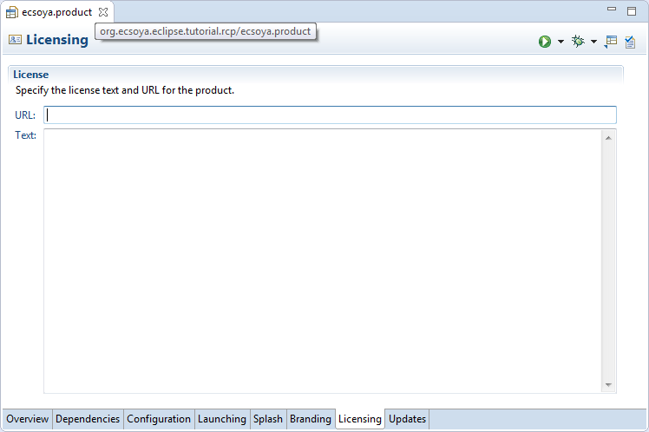
Product Configuration
License

Slide 14
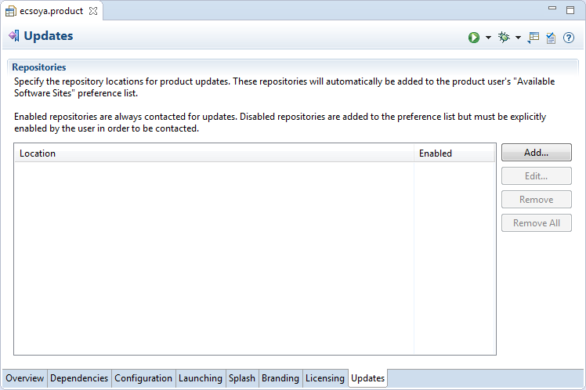
Product Configuration
Updates

Slide 15
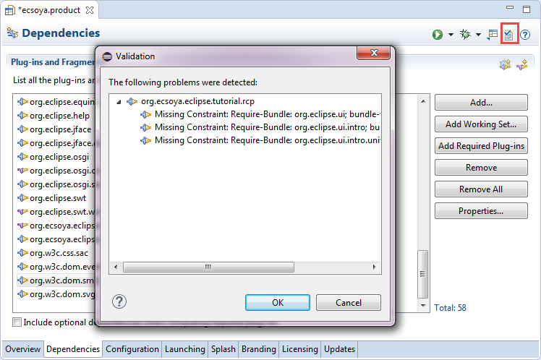
Publish
Validation

Slide 16
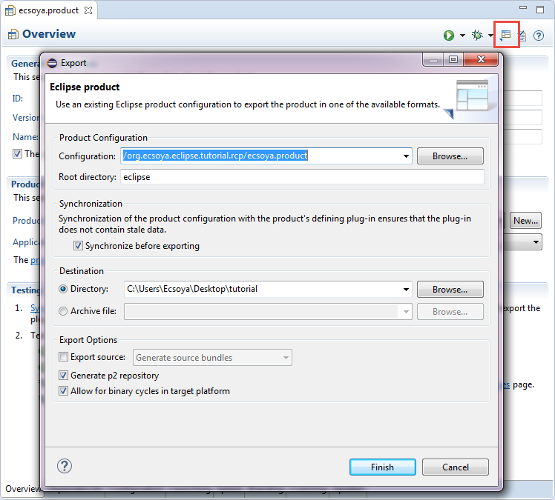
Product Configuration
Export

Slide 17
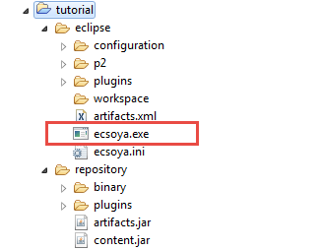
Product Configuration
Export

Slide 18
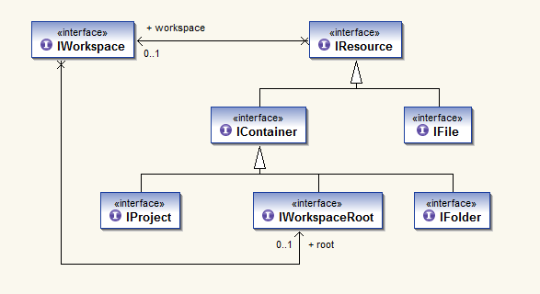
Resources Hierarchy
org.eclipse.core.resources

Slide 19
Resources Hierarchy
IWorkspace
IWorkspace workspace = ResourcesPlugin.getWorkspace();
IWorkspaceRoot root = workspace.getRoot();
IProject[] projects = root.getProjects();
workspace.addResourceChangeListener(new IResourceChangeListener() {
public void resourceChanged(IResourceChangeEvent event) {
}
});

Slide 20
Resources Hierarchy
Create Resource
IProject project = root.getProject();
IFolder folder = project.getFolder("Ecsoya");
if (!folder.exists()){
try {
folder.create(IResource.DEPTH_INFINITE, true, null);
} catch (CoreException e) {
e.printStackTrace();
}
}

Slide 21
Resources Hierarchy
Delete Resource
IProject project = root.getProject();
IFolder folder = project.getFolder("Ecsoya");
if (folder.exists()) {
try {
folder.delete(true, null);
} catch (CoreException e) {
e.printStackTrace();
}
}

Slide 22
Resources Hierarchy
Common Navigator View
org.eclipse.ui.views
org.eclipse.ui.navigator.viewer
Resource Providers
WorkbenchContentProvider
WorkbenchLabelProvider

Slide 23
Any Questions?
Skype: jin.liu.soyatec
Email: jin.liu@soyatec.com

Slide 24
The end

